Slide 1


Joel Tan
29 Jan 2022

Slide 2

Outline
Executive Summary
Introduction
Methodology
Results
Conclusion
Appendix

Slide 3
Executive Summary
Summary of methodologies
Data Collection
Exploratory Data Analysis
Create interactive Maps with Folium
Create Dashboard with Plotly
Run Machine Learning Models
Summary of all results
EDA
Maps and Dashboard
Result of the different models

Slide 4
Introduction
Project Background
Taken from Week 1 Introduction:
“In this capstone, we will predict if the Falcon 9 first stage will land successfully. SpaceX advertises Falcon 9 rocket launches on its website, with a cost of 62 million dollars; other providers cost upward of 165 million dollars each, much of the savings is because SpaceX can reuse the first stage. Therefore, if we can determine if the first stage will land, we can determine the cost of a launch. This information can be used if an alternate company wants to bid against SpaceX for a rocket launch.”

Slide 5

Section 1

Slide 6
Methodology
Executive Summary
Data collection methodology:
Data was collected from SpaceX API and from web scraping from Wikipedia
Perform data wrangling
Irrelevant columns were dropped, new columns created and renamed, Falcon 9 data was isolated and finally null values were filled.
Perform exploratory data analysis (EDA) using visualization and SQL
Perform interactive visual analytics using Folium and Plotly Dash
Perform predictive analysis using classification models
Standardize the data
Split data into training and test sets
Find the model that performs the best

Slide 7
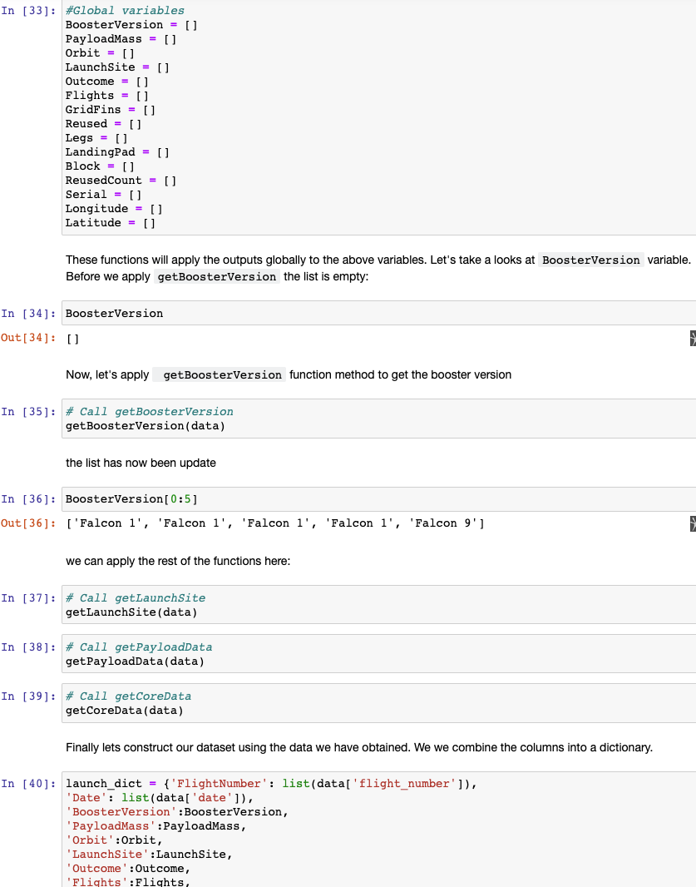
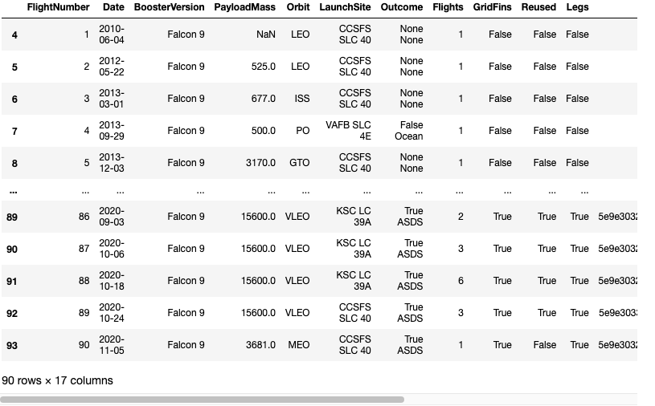
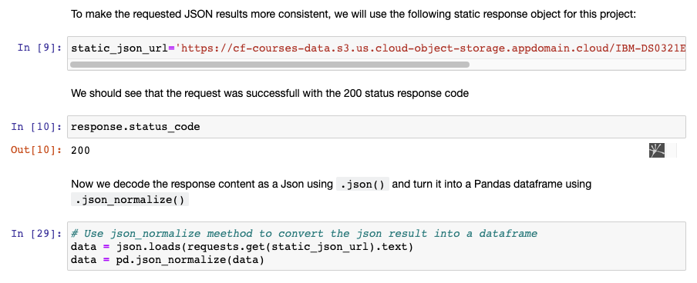
Data Collection – SpaceX API
GitHub Link here
Request and parse the SpaceX launch data using GET request
Select required data from the response and store them into separate list
Create a Data Frame from the list of data collected

Slide 8
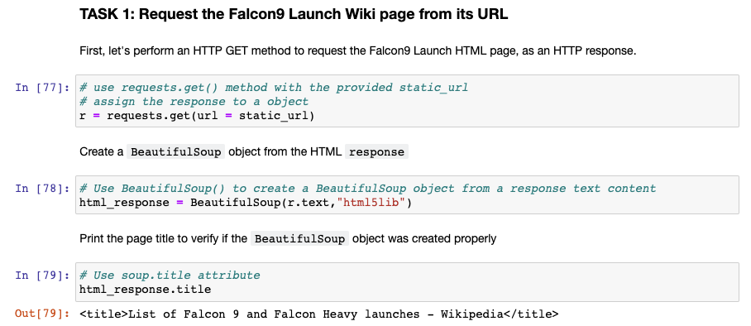
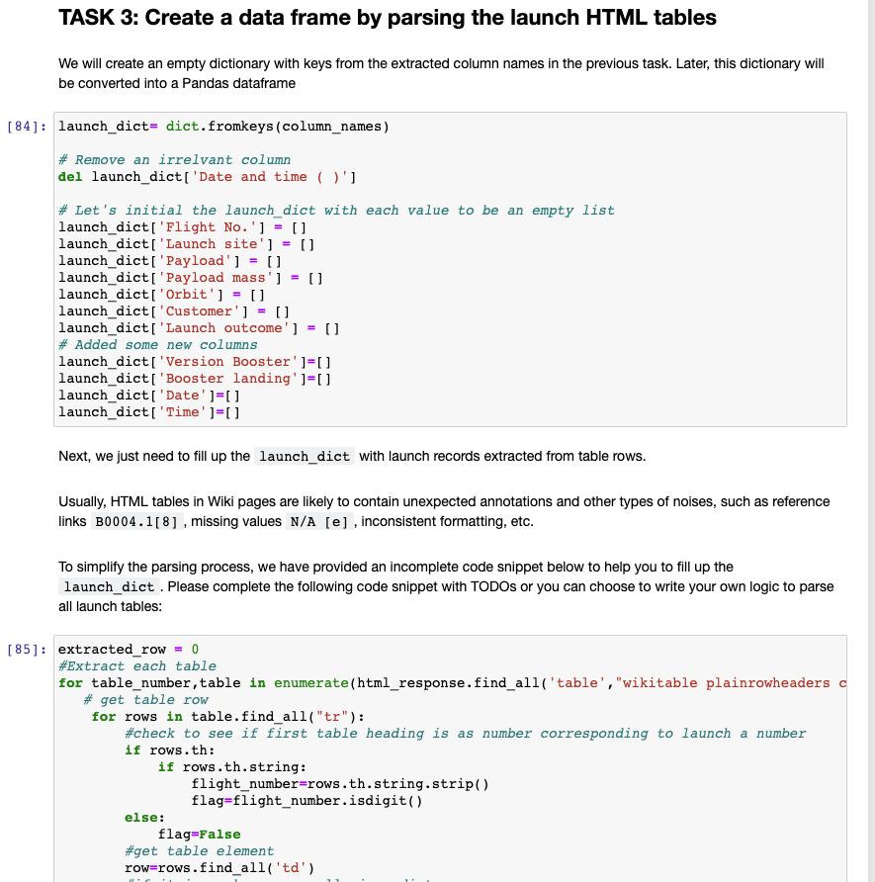
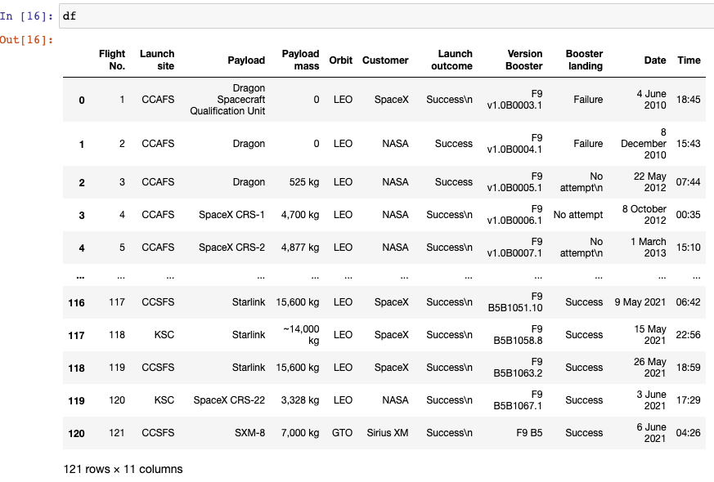
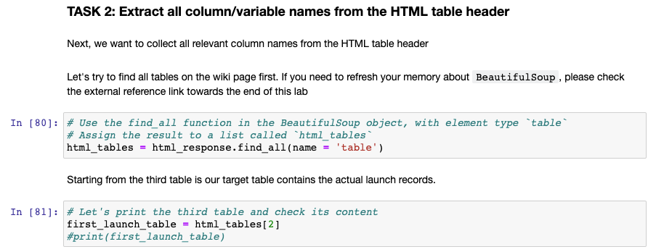
Data Collection - Scraping
GitHub URL here
Final Result

Slide 9
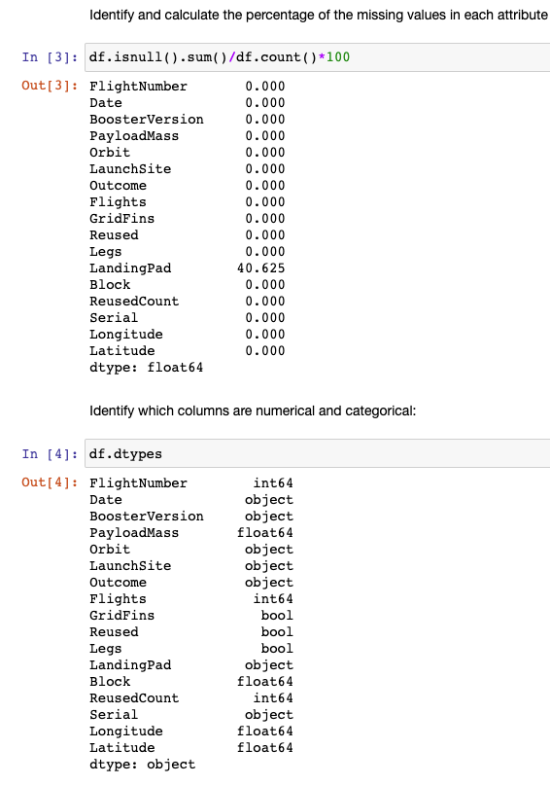
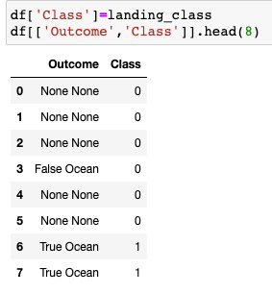
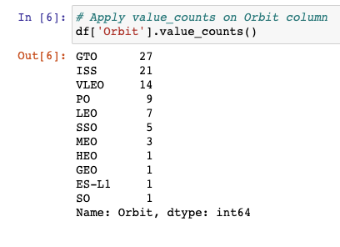
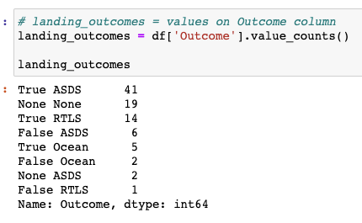
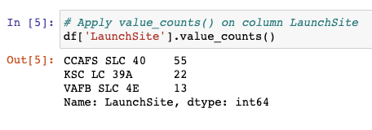
Data Wrangling
GitHub URL here
we will perform some Exploratory Data Analysis (EDA) to find some patterns in the data and determine what would be the label for training supervised models.
In the data set, there are several different cases where the booster did not land successfully. Sometimes a landing was attempted but failed due to an accident; for example, True Ocean means the mission outcome was successfully landed to a specific region of the ocean while False Ocean means the mission outcome was unsuccessfully landed to a specific region of the ocean. True RTLS means the mission outcome was successfully landed to a ground pad False RTLS means the mission outcome was unsuccessfully landed to a ground pad. True ASDS means the mission outcome was successfully landed on a drone ship False ASDS means the mission outcome was unsuccessfully landed on a drone ship.
We will mainly convert those outcomes into Training Labels with 1 means the booster successfully landed 0 means it was unsuccessful.
Perform simple EDA: look for null values, and identify data type
Calculate the number of launches on each site
Calculate the number and occurrence of each orbit
Create a landing outcome label from Outcome column
Calculate the number and occurence of mission outcome per orbit type

Slide 10
EDA with Data Visualization
GitHub URL here
Charts Used
Scatter plot relationship between Flight Number and Launch Site
Scatter plot relationship between Payload and Launch Site
Bar plot relationship between success rate of each orbit type
Scatter plot relationship between Flight Number and Orbit type
Scatter plot relationship between Payload and Orbit type
Line plot launch success yearly trend

Slide 11
EDA with SQL
GitHub URL here
SQL queries performed
Display the names of the unique launch sites in the space mission
Display 5 records where launch sites begin with the string 'CCA’
Display the total payload mass carried by boosters launched by NASA (CRS)
Display average payload mass carried by booster version F9 v1.1
List the date when the first successful landing outcome in ground pad was achieved.
List the names of the boosters which have success in drone ship and have payload mass greater than 4000 but less than 6000
List the total number of successful and failure mission outcomes
List the names of the booster_versions which have carried the maximum payload mass. Use a subquery
List the failed landing_outcomes in drone ship, their booster versions, and launch site names for in year 2015
Rank the count of landing outcomes (such as Failure (drone ship) or Success (ground pad)) between the date 2010-06-04 and 2017-03-20, in descending order

Slide 12
Build an Interactive Map with Folium
GitHub URL here
Objects created and added to folium map
Mark all launch sites on the map
Draw an Equator line
Mark the success/failed launches for each site on the map
Mark and trace the nearest: city, railroad, highway and coastline to a launch site.
Explanation
Find some geographical patterns about launch sites because:
“The launch success rate may depend on many factors such as payload mass, orbit type, and so on. It may also depend on the location and proximities of a launch site, i.e., the initial position of rocket trajectories. Finding an optimal location for building a launch site certainly involves many factors and hopefully we could discover some of the factors by analyzing the existing launch site locations.”

Slide 13
Build a Dashboard with Plotly Dash
GitHub URL here
Plots/graphs and interactions added to dashboard
Add a Launch Site Drop-down Input Component
Created a Pie Chart to show rate of successful launches
Added a Range Slider to filter Payload Range
Created a Scatter plot to show different Payload success or failure
Explanation
This would give insights into SpaceX successful launch data and answer questions such as:
Which site has the largest successful launches?
Which site has the highest launch success rate?
Which payload range(s) has the highest launch success rate?
Which payload range(s) has the lowest launch success rate?
Which F9 Booster version (v1.0, v1.1, FT, B4, B5, etc.) has the highest

Slide 14
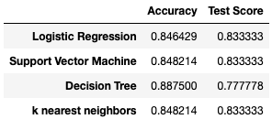
Predictive Analysis (Classification)
GitHub URL here
Perform exploratory Data Analysis to determine Training Labels
create a column for the class
Standardize the data
Split into training data and test data
Find best Hyperparameter for SVM, Classification Trees, K Nearest Neighbour and Logistic Regression
Find and compare the method that performs best using test data
Create a NumPy array from the column class in dataframe , by applying the method to_numpy() then assign it to the variable Y
Standardize the data in X then reassign it to the variable X using StandardScaler and fit transform
Use the function train_test_split to split the data X and Y into training and test data. Set the parameter test_size to 0.2 and random_state to 2
Create the different models (SVM, Classification Trees, K Nearest Neighbour, Logistic Regresssion) and use GridSearchCV to find the best parameters for each model
Calculate the accuracy and score for each model
Generate the confusion matrix for each model
Compare the result to come to a final choice

Slide 15

Section 2

Slide 16
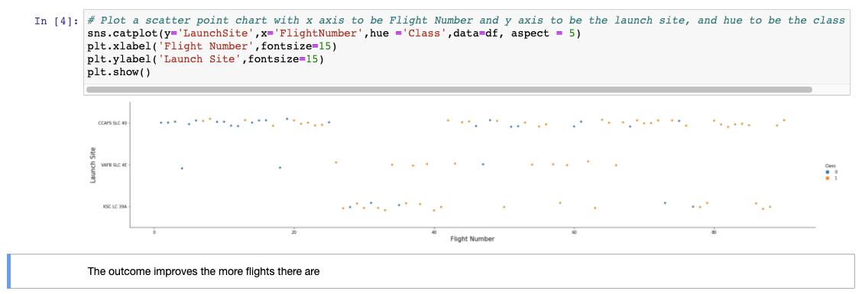
Flight Number vs. Launch Site

Slide 17
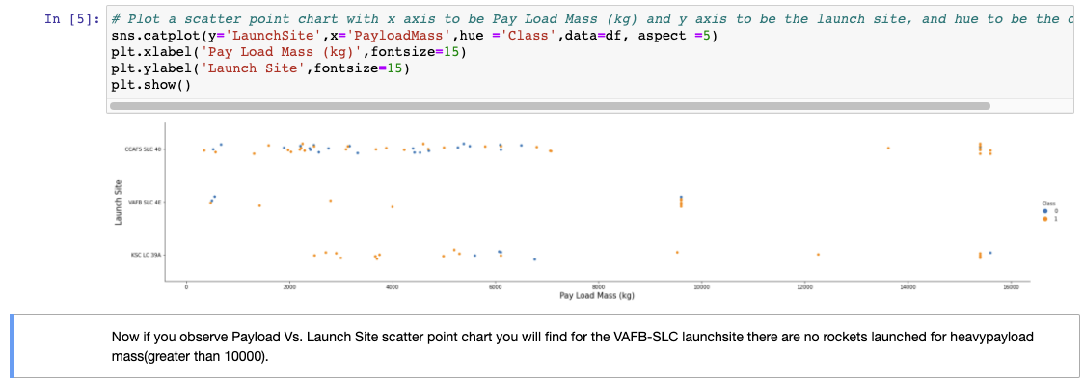
Payload vs. Launch Site

Slide 18
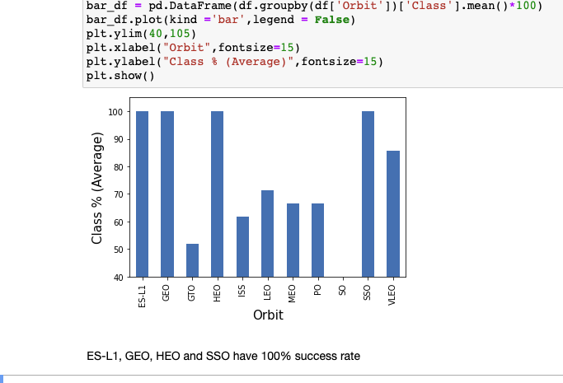
Success Rate vs. Orbit Type

Slide 19
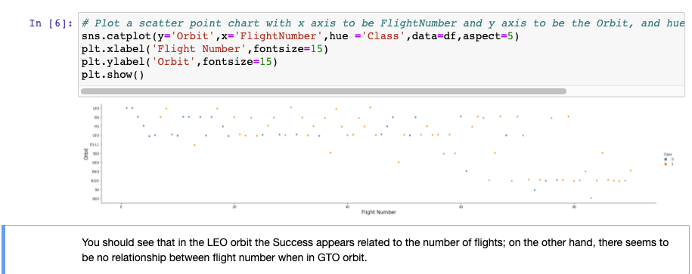
Flight Number vs. Orbit Type

Slide 20
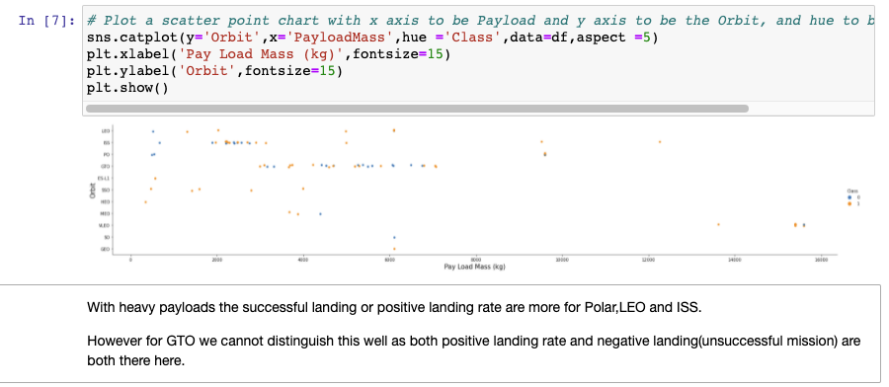
Payload vs. Orbit Type

Slide 21
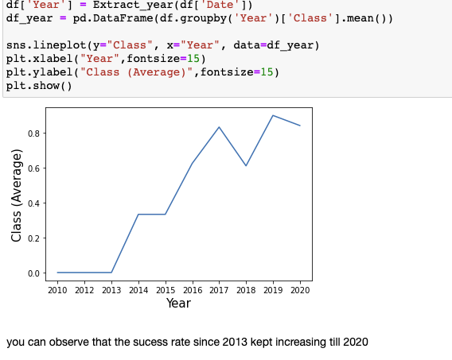
Launch Success Yearly Trend

Slide 22
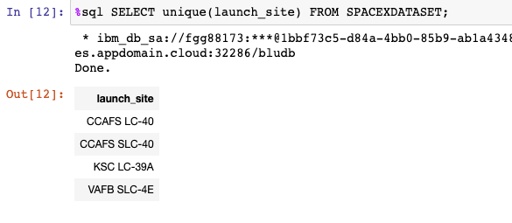
All Launch Site Names
There are 4 unique launch sites

Slide 23
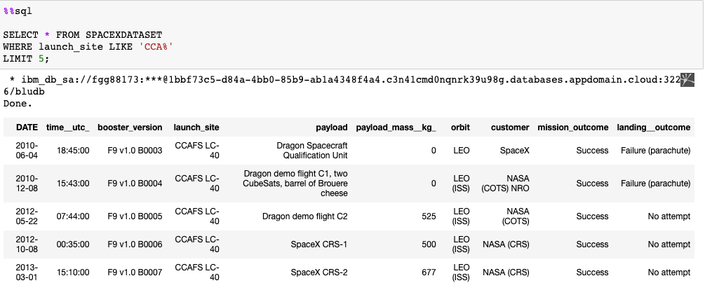
Launch Site Names Begin with 'CCA'
5 records where launch sites begin with `CCA`

Slide 24
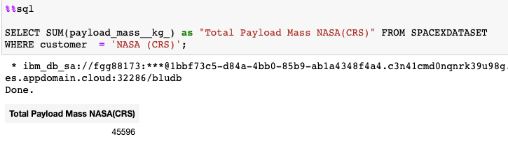
Total Payload Mass
The total payload carried by boosters from NAS 45596

Slide 25
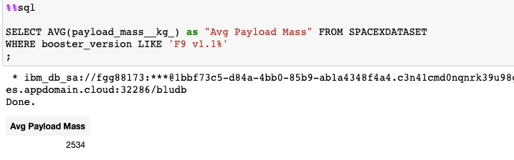
Average Payload Mass by F9 v1.1
The average payload mass carried by booster version F9 v1: 2534

Slide 26
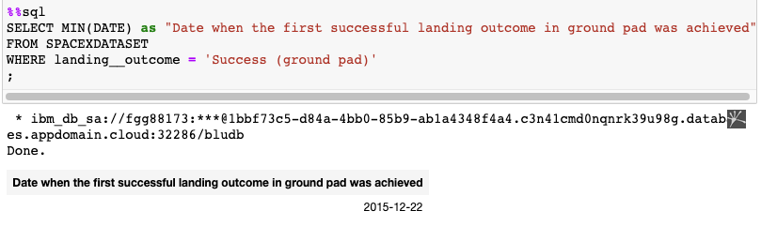
First Successful Ground Landing Date
The date of the first successful landing outcome on ground pad: 22 Dec 2015

Slide 27
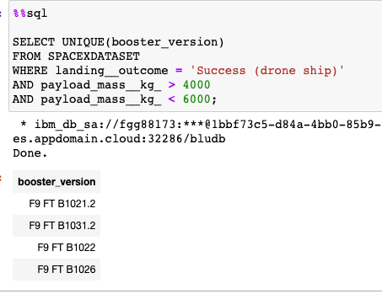
Successful Drone Ship Landing with Payload between 4000 and 6000
Names of the 4 boosters which have successfully landed on drone ship and had payload mass greater than 4000 but less than 6000

Slide 28
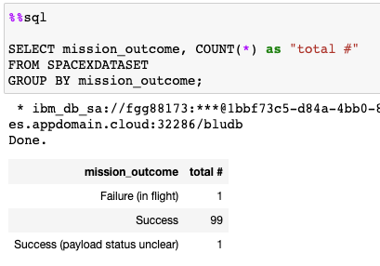
Total Number of Successful and Failure Mission Outcomes
The total number of successful and failure mission outcome

Slide 29
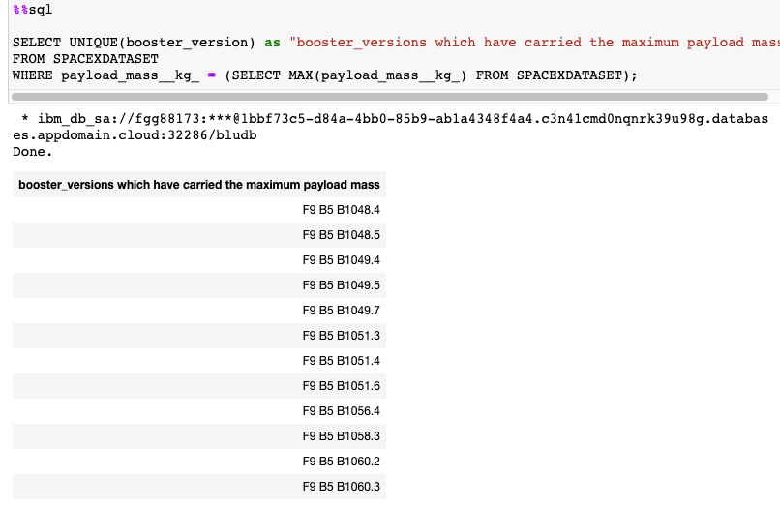
Boosters Carried Maximum Payload
The names of the booster which have carried the maximum payload mass

Slide 30
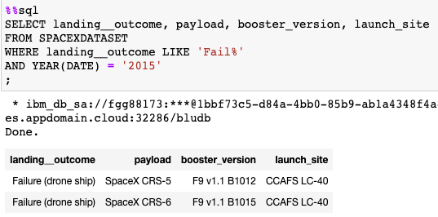
2015 Launch Records
Failed landing_outcomes in drone ship, their booster versions, and launch site names for in year 2015

Slide 31
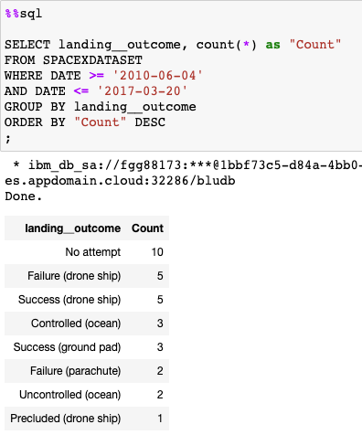
Rank Landing Outcomes Between 2010-06-04 and 2017-03-20
Rank the count of landing outcomes (such as Failure (drone ship) or Success (ground pad)) between the date 2010-06-04 and 2017-03-20, in descending order

Slide 32

Section 3

Slide 33
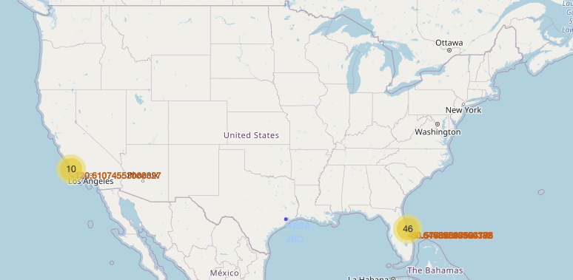
Folium Map Location of the launch Sites
The launch sites are generally grouped together on the lower end of both the east and west coastlines.

Slide 34
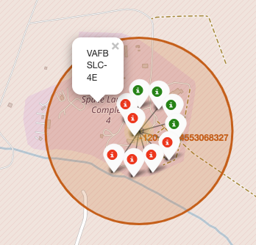
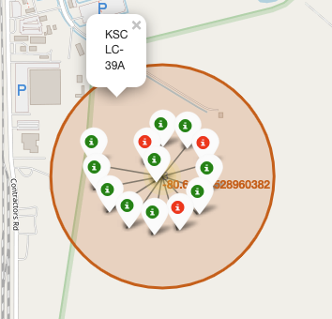
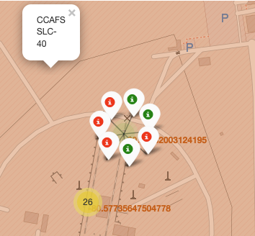
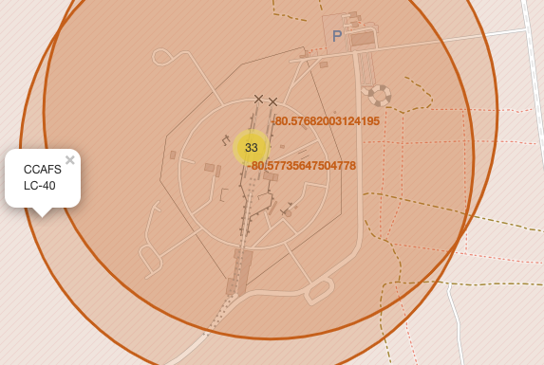
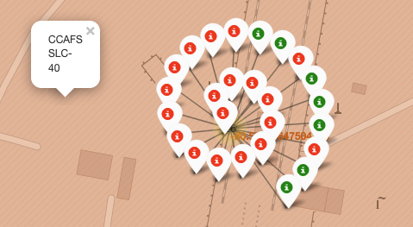
Folium Map Color Labeled Launch Outcomes
These are the color labeled launch outcomes for the different launch sites
CCAFS SLC-40 and CCAFS LC-40 are so closed together that they overlap, and it is not easy to different between the two

Slide 35
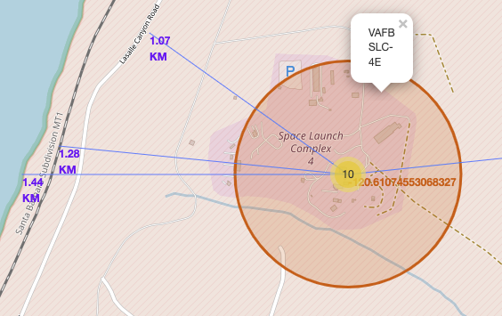
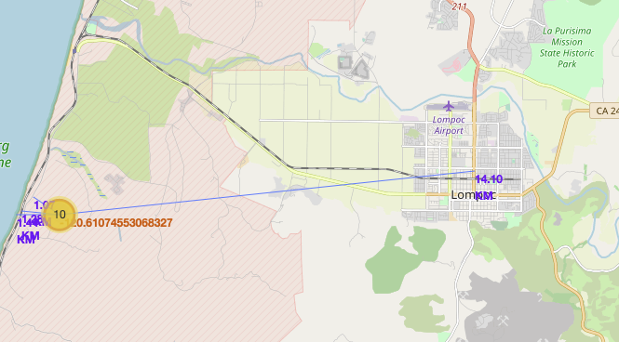
Folium Map VAFB SLC-4E launch site proximity to infrastructures
The launch site is very close to railroads, highways and the coastline. But it is quite a distance from the nearest city, Lompoc.

Slide 36

Section 4

Slide 37
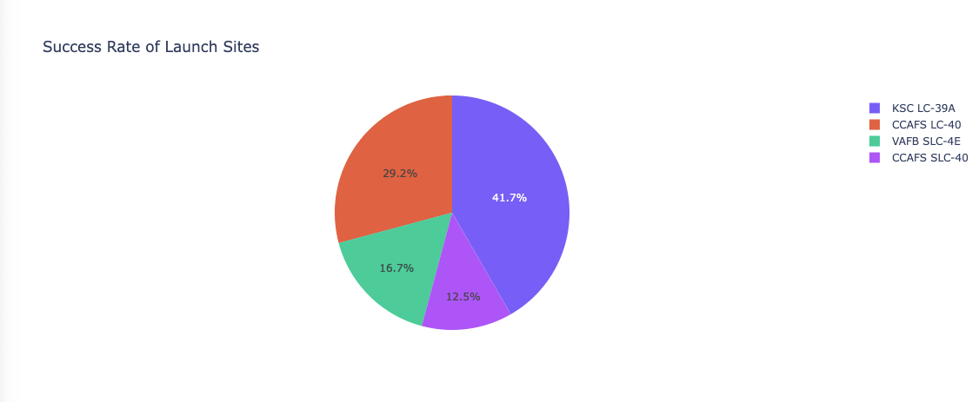
Dashboard Pie Chart of Share of Success
From this we can see that KSC LC-39A has the lion share of success at 41.7% and CCAFS SLC-40 is struggling at 12.5%

Slide 38
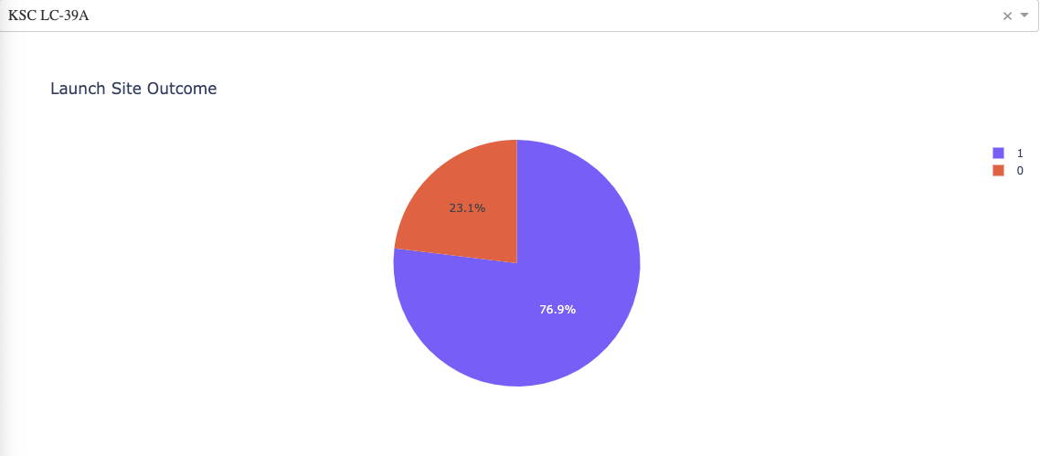
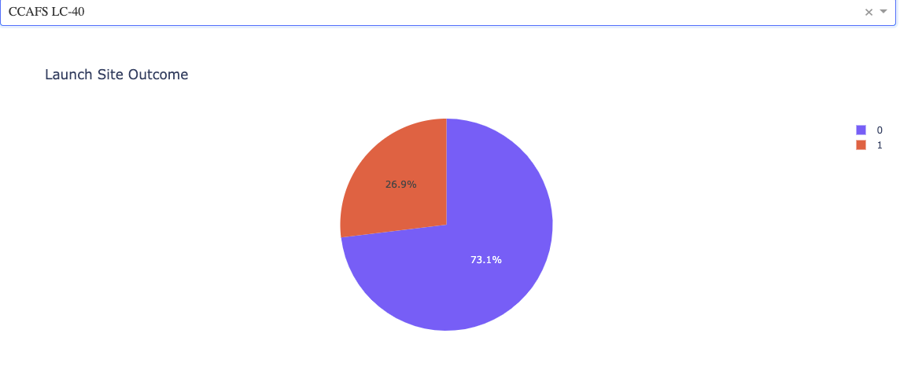
Dashboard KSC LC-39A: Highest Launch Success Ratio
At 76.9% KSC LC-39A has the high launch success rate but CCAFS LC-40 is not that far behind with 73.1%

Slide 39
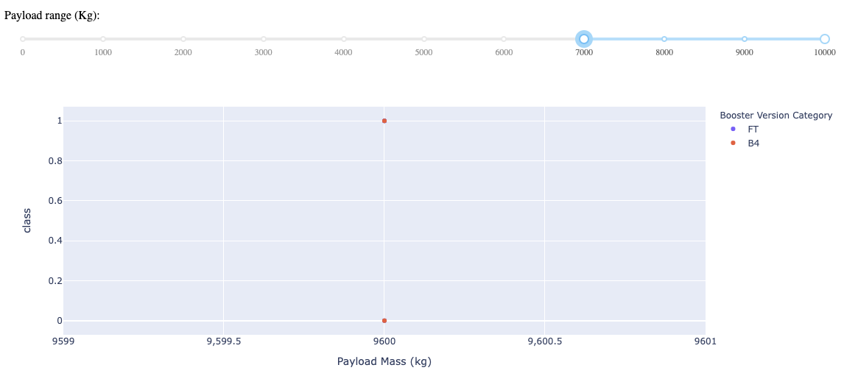
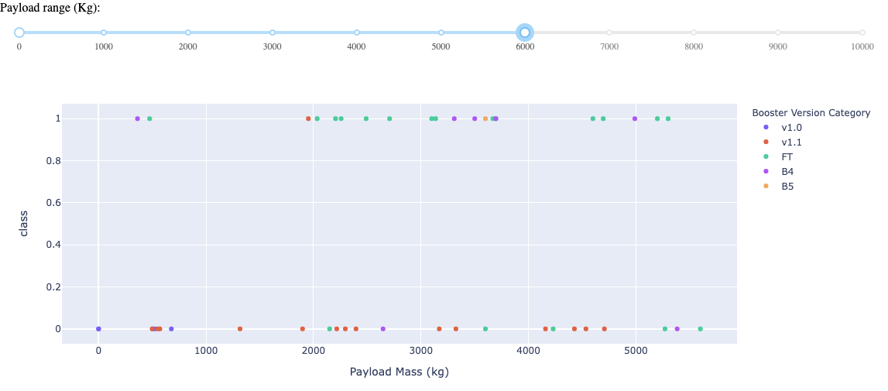
Dashboard Comparing Payload vs Launch Outcomes
Not many payloads above 7,000kg
Results are fairly mixed for those 6,000kg and below

Slide 40

Section 5

Slide 41
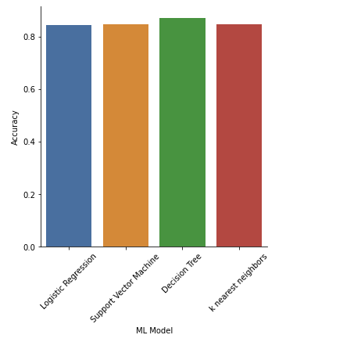
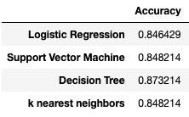
Classification Accuracy
The models have all very close accuracy alittle above 84%.
However, the Decision Tree Model has a slight edge at 87%.

Slide 42
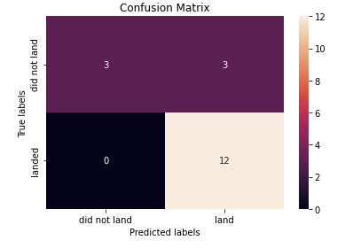
Confusion Matrix for Decision Tree
This is the confusion matrix on the test data results in comparison to the actual result.
For land, the classifier had a False Positive for 3 of the data.
The rest it has managed to predict accurately.

Slide 43
Conclusions
The Decision Tree was the best out of the 4 classifiers in terms of accuracy, however its edge is only 2% odd. In terms of the confusion matrix, it actually performed similarly to the other models.
The success of a mission drastically increase as the team has more launches under their belt.
Launch Sites seems to favor areas far from the city, but near to highways, railroads and the coastlines.
KSC LC-39A could be considered the most successful of the launch sites perhaps more studies could be done on this particular site to better improve the success rate of the others.

Slide 44
Appendix
NA

Slide 45


